Slide 1
Business Analytics
Toolbox - BA775
Summer 2021
Lecture 04
Professor: Mohammad Soltanieh-ha

Slide 2
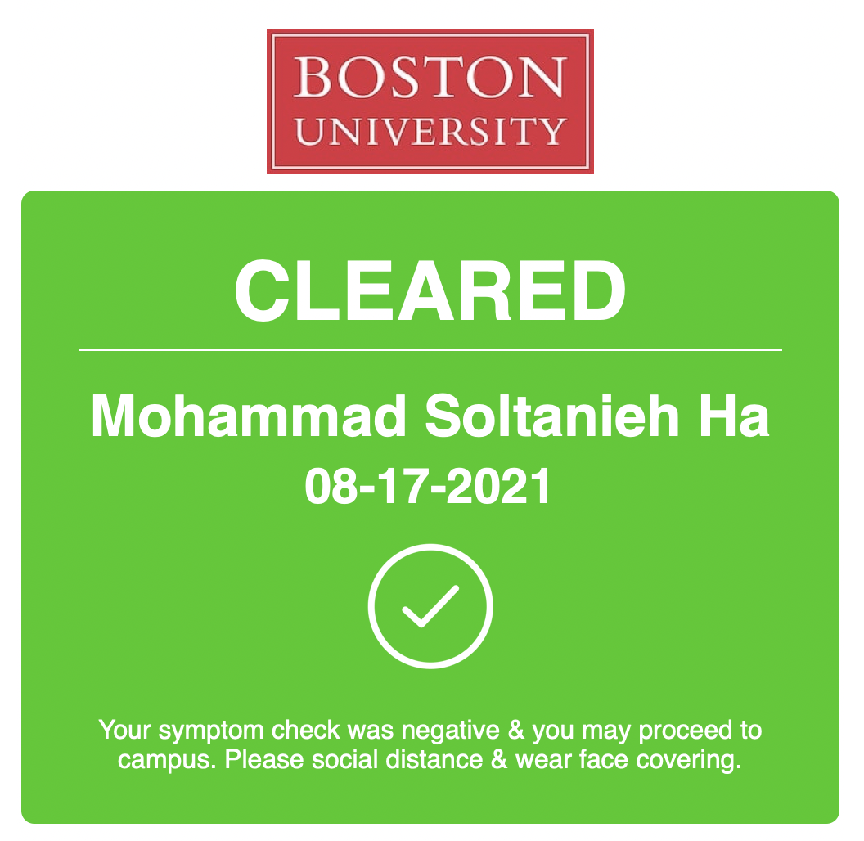

Slide 3
Topics Covered
Google Analytics
WITH SQL clause
Teaming
Team project and assignment
Troubleshooting Common SQL

Slide 4
WITH SQL Clause
You can use the SQL WITH clause to help break apart a complex query into multiple steps.
WITH hamlet AS
(SELECT * EXCEPT (corpus_date) FROM `bigquery-public-data.samples.shakespeare`
WHERE corpus = 'hamlet')
SELECT word from hamlet
ORDER BY word_count DESC

Slide 5
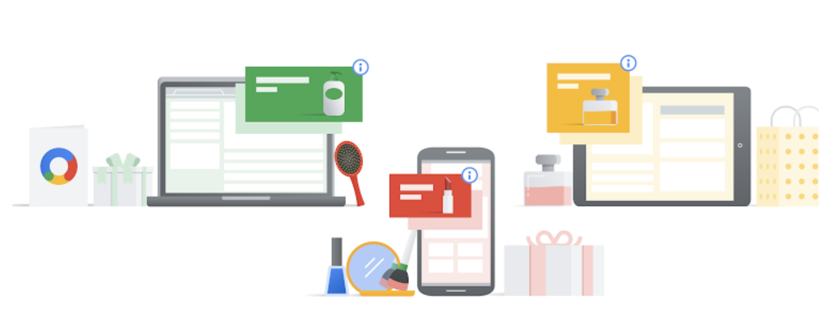
Google Analytics
Google Analytics is a web analytics service that tracks and reports website traffic. It is the most widely used web analytics service on the web.
It tracks the website activity of the users such as session duration, pages per session, bounce rate, etc. along with the information on the source of the traffic. It shows high-level, dashboard-type data for the casual user, and more in-depth data further into the report set.

Slide 6
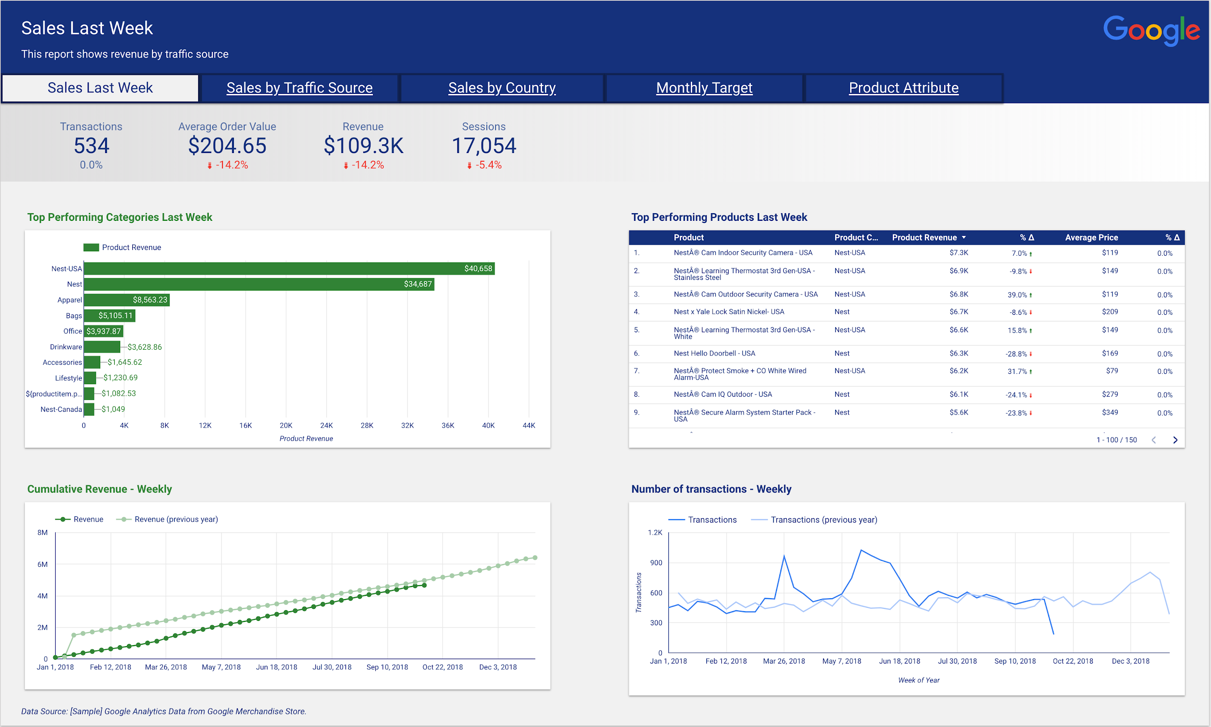
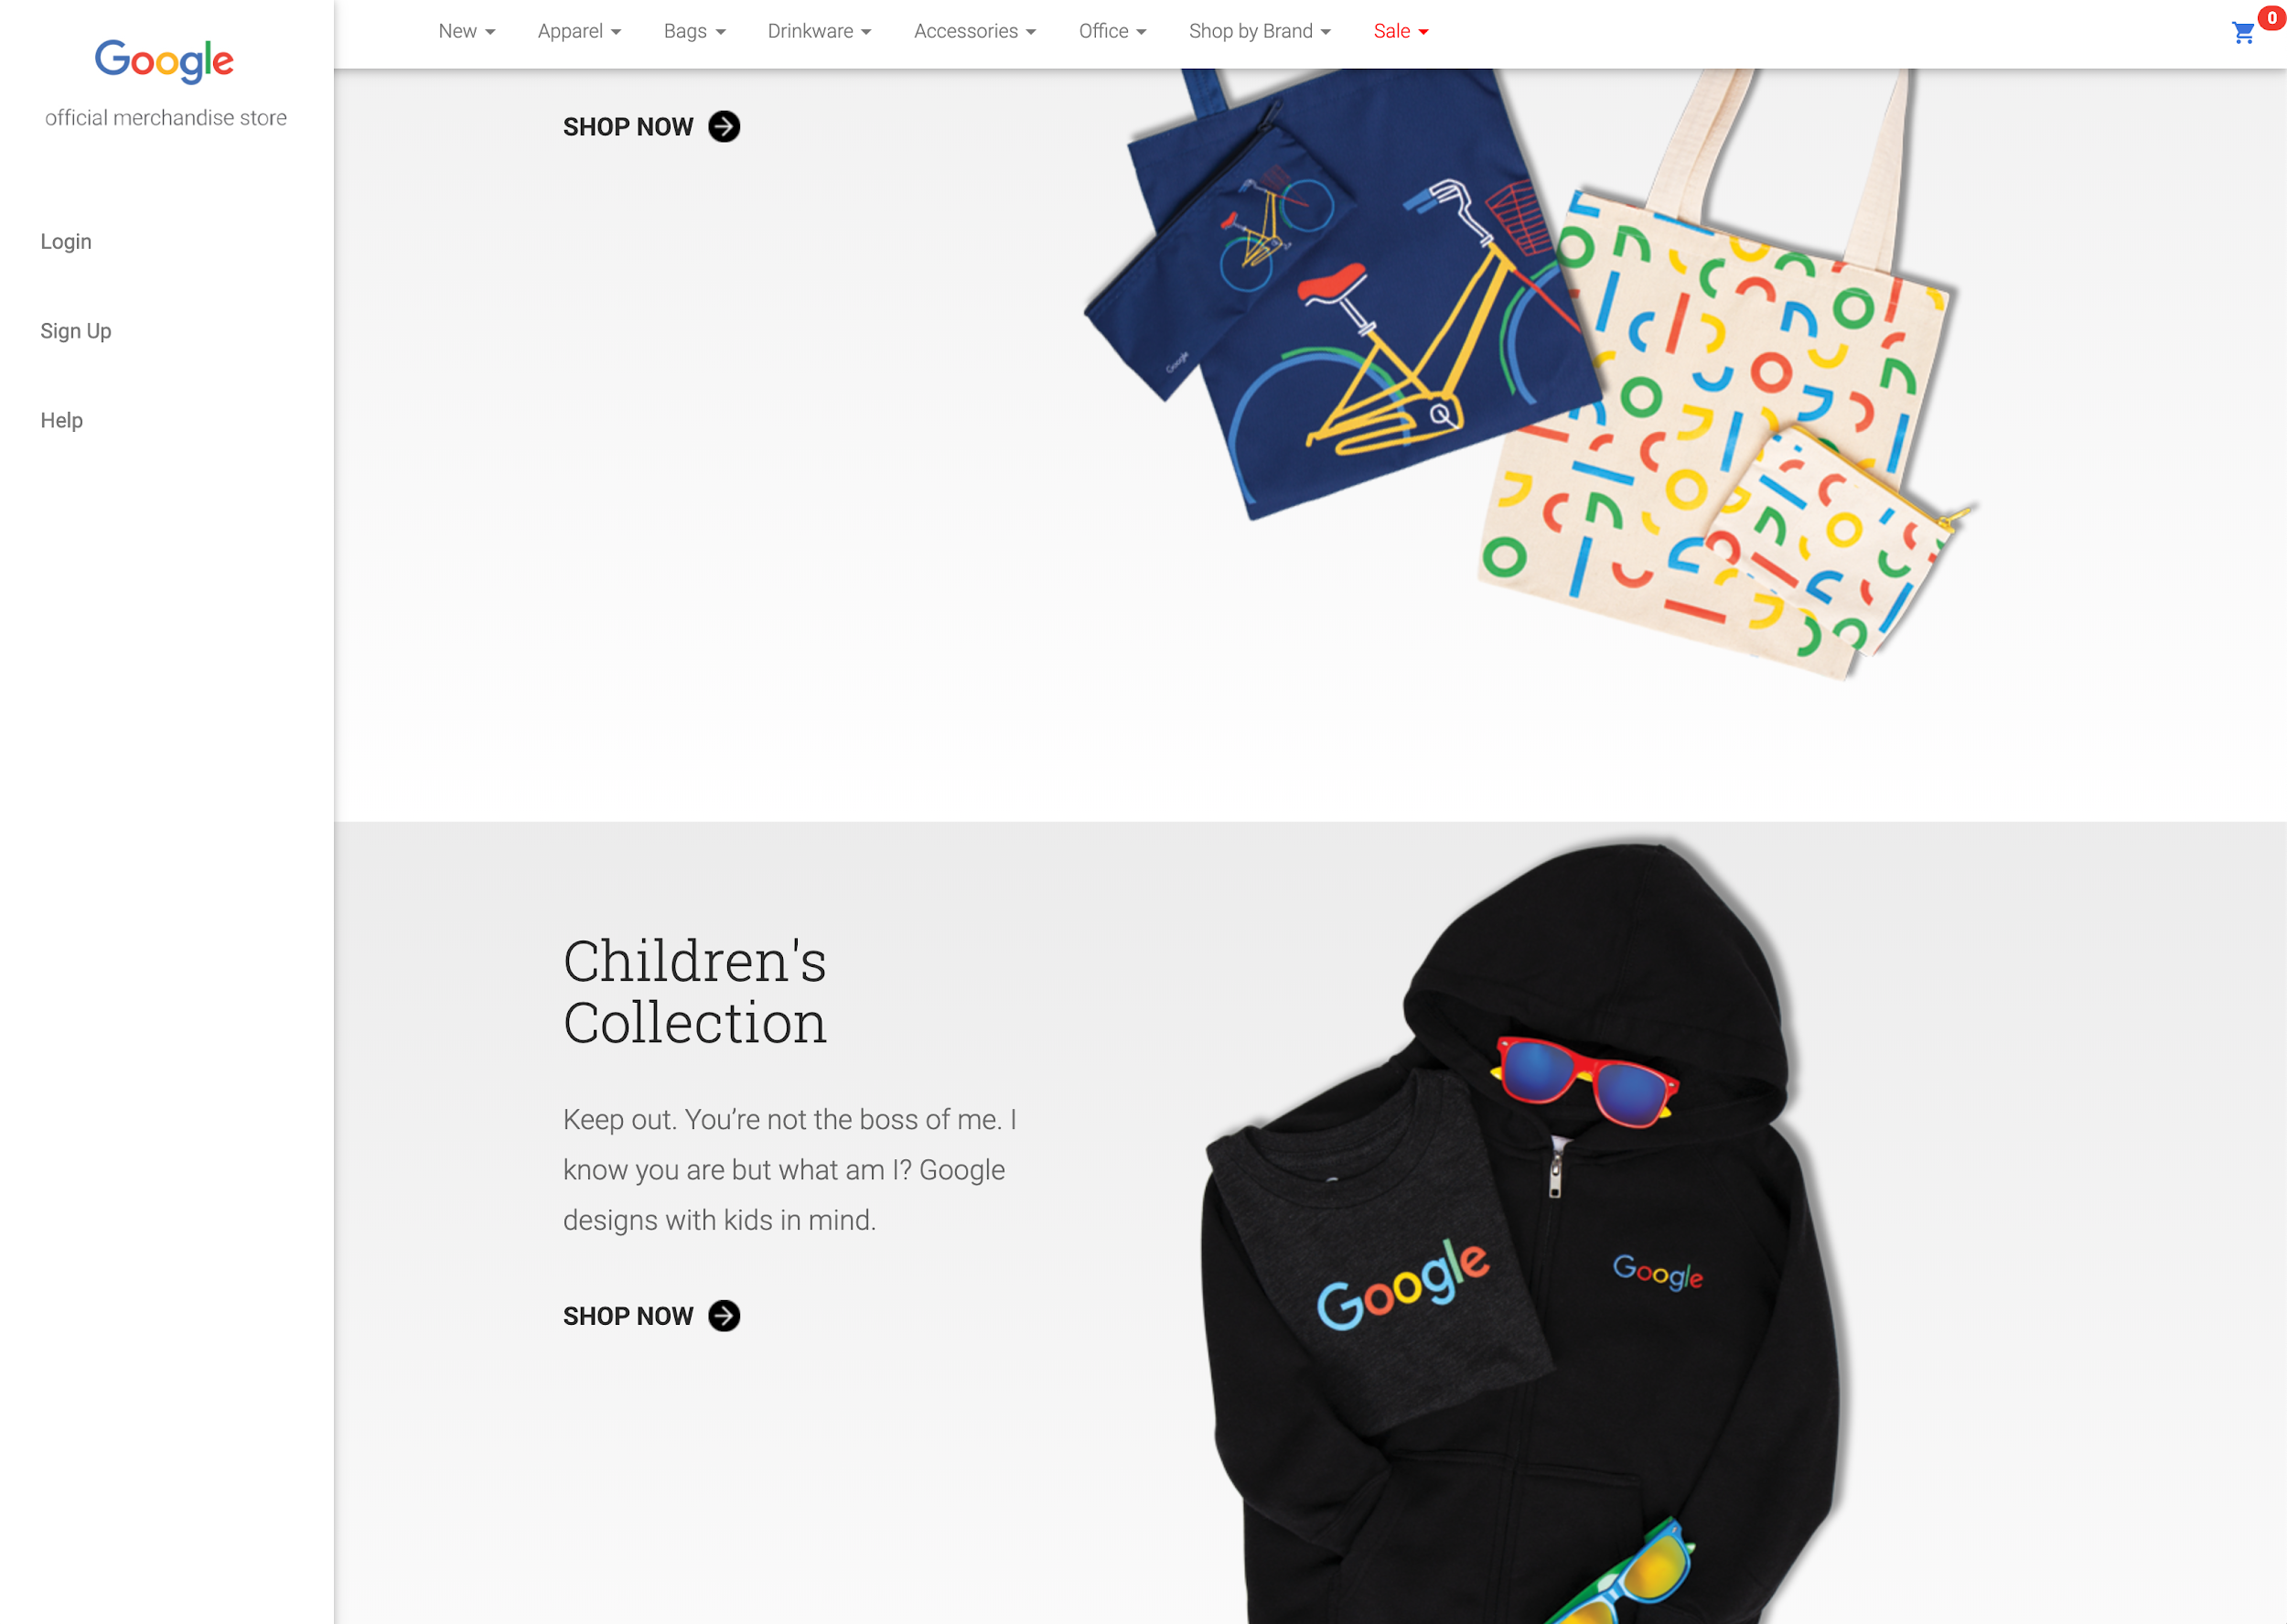
Google Merchandise Store
Google Merchandise Store is an online platform where Google branded products are sold. In QLab I we will analyze this live ecommerce data.

Slide 7

Teaming + Slack Channel
Class list with teams info can be found here.

Slide 8
Create Slack channels
Leads: set up Slack channels
Setup two private channel
Invite your teammates only
Call it ba775-team1-b1-students (team 1 cohort B1, for instance)
Invite your teammates + the instructor
Call it ba775-team1-b1-w-professor (team 1 cohort B1, for instance)

Slide 9
Create a GCP Project for Your Team
Leads: set up a GCP project
Give the project a good name
From GCP menu go to Billing > Go to linked billing account. Make sure that you see your project name under your coupon
Share the project with your teammates
From GCP menu go to IAM & admin
From the top “Add” a member
In the box use your team members’ BU email address
For role: give them project > owner
Then send the invitation
Others follow the link in your email and accept the invitation
Note: it could take a while for everyone to receive the invitation.

Slide 10
Team Project
Team leads:
Please set up a time so your team can discuss the potential projects that everyone is interested in.
Once you all agree on the problem definition and dataset Slack me (within the private channel with me and your teammates). This short response should explain what dataset you are planning to use and what problem you would like to tackle. Please include a link to the source of your dataset. Your problem formulation should be clear and around one paragraph.
Phase 1) Project proposal - details: dataset + team project proposal
Deadline: 08/23 - the sooner the better
Phase 2) Team assignment
Deadline: 08/26
Phase 3) Final project deliverables
Deadline: 08/30 @ 5 p.m.
Final presentation
08/31

Slide 11
Team Assignment
Phase 2: Due Aug 26
This assignment is to create a report of your project’s dataset. You have to describe your data, and provide useful summary and visualization (optional).
The deliverable is an easy-to-read and well-organized Vertex AI notebook that includes:
the business problem that you are trying to solve + a brief description of your data and its source
the exploratory phase of your project
some basic questions about your data and answers to them
This assignment doesn’t have solid rules. However, it is expected from you to do data profiling of your dataset. The more you dig into your data the better your final project outcome would be.
By the end of this assignment you may decide that you need to change your original problem and that’s totally OK, given that you provide appropriate reasons for your decision.
Please share your notebook (.ipynb) with me via your team’s Slack channel.

Slide 12

Activity
DataCamp
Ch 3.1 Joining Data in SQL - Introduction to joins
Due Thursday - 08/19
Assignment 1
Due Thursday - 08/19
Team Assignment Phase 1 (proposal: dataset + problem)
Due Monday - 08/23
Team Assignment Phase 2 (summary report)
Due Thursday - 08/26

Slide 13
Your Turn
QLab I: Exploring Your Ecommerce Dataset with SQL in Google BigQuery - 00:30
What you will learn in this lab
Use Schema, Details, and Review tabs to get a sense of the dataset
Detect duplicate records using COUNT, GROUP BY, and HAVING
Write and execute basic SQL queries on ecommerce data using SELECT, FROM, WHERE, GROUP BY, ORDER BY, and LIMIT

Slide 14

Your Turn
QLab J: Troubleshooting Common SQL Errors with BigQuery - 00:50
What you will learn in this lab
Use the BigQuery Query editor to troubleshoot common SQL errors
Use the Query Validator
Troubleshoot syntax and logical SQL errors
NOTE: This lab is particularly important as you most likely will have to troubleshoot your code or someone else’s at some point.

Slide 15

Mid-term Feedback
Please take a few minutes to complete this mid-term feedback:

